Slide 1
Virtual Reality suite toolset to run projects and studies easily
Bradley Pursglove
Notes:
Hi everyone, I’m Bradley Pursglove and welcome to my project presentation.
I’m going to be outlining the aim and objectives of my dissertation project, giving a bit of background into this specific area of research, describing the work involved in solving this problem, how I plan to carry out those tasks and also how I will measure their success.

Slide 2
Aim & Objectives
To develop a toolset for the CAVE virtual reality suite, in order to run projects and studies easily
Create 3D architectural visualizations that can be navigated and explored using the VR suite
Increase the share-ability of the CAVE through the use of the web and open-source technologies
Integrate head-tracking and collision detection when available in order to provide an immersive experience
Support the loading of 3D models of various types to ensure that the toolset is widely useable
Provide logging of user interaction so that the suite can be a suitable location for psych studies and demos
Notes:
The main aim of my project is to successfully implement a toolset for use in the university's CAVE virtual reality suite. This backend program will allow various projects and studies to be run with ease through simplifying the deployment of 3D models.
In order to achieve this I have set myself a number of objectives; the first of these is to take advantage of the features that the VR suite provides and create 3D architectural visualisations that can be traversed using this technology.
Another goal is to make this technology as shareable as possible, as it is sometimes the case that a particular application for the VR suite may need to be run on a laptop offsite, for example. It is also possible that certain studies or demos could benefit greatly from being able to be run independently of the VR suite.
I also intend on integrating both head-tracking and collision detection within the toolset whenever available. Through doing this I plan to achieve a unique and immersive experience, with many possible applications.
One more target of this toolset is to successfully load 3D models of varying types and formats, which will make it relevant and useful for a much wider range of potential users.
In addition I will implement methods of logging user interaction. As a result of this my toolset will be able to be used appropriately for both psych studies and demos.
By nature this is a particularly feature-based project, meaning that most of my objectives are to implement specific features into the toolset. That is, my project will be based primarily around development and less so around research, as the main aim at the end of my dissertation is to deliver a useful and working program that can realistically be used.

Slide 3
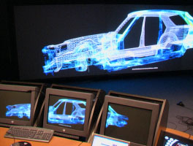
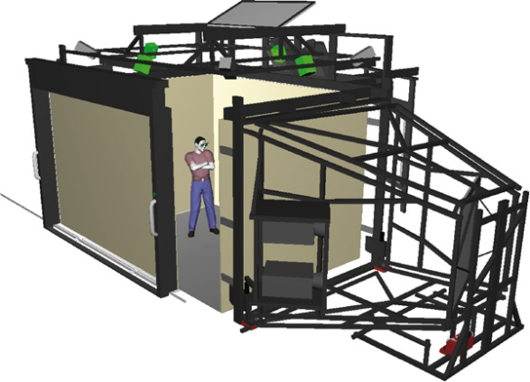
Introduction
CAVE (cave automatic virtual environment)
Room-sized cube, created through the use of multiple rear-projected screens
Motion tracking provided by infrared sensors
Stereo glasses to deliver 3D images
http://picanteverde.github.io/3dtv/src/tv3d5.html
Motion parallax
Notes:
CAVE is the acronym for a cave automatic virtual environment, which describes a space generally the size of an average room, that is completely surrounded by rear-projection screens. There can be anywhere between 3 and 6 of these screens (although this is ever-increasing with the new CAVE2 system being announced, which has a total of 72 near seamless displays), with each providing a viewpoint of or into a 3D model or environment. In particular, Newcastle’s CAVE has three rear-projected screens, which surround the user from the front and both sides.
A user within the CAVE will be wearing glasses that are tracked and followed by infrared cameras within the frame of the CAVE system. In doing this both motion tracking and head tracking can be achieved, allowing the user to literally walk around their environment and also rotate their view by simply moving their head.
The 3D images are achieved through the stereoscopic glasses that the user wears. They work by displaying both left and right–eye views to the user simultaneously, each slightly offset from the other to give the impression that both eyes are receiving a slightly different view. These images are then combined in the users brain to provide a single binocular view and resulting in a realistic and believable 3D image.
This (CLICK LINK) demonstrates how a stereo image is displayed to the user. Although both images are displaying the exact same models, you might not be able to notice that they have been rendered slightly offset to each other, allowing the eye to interpret this as 3D when “combined” in the brain.
This is known as motion parallax, which is the difference in the apparent position of an object when viewed along two different lines of sight.

Slide 4
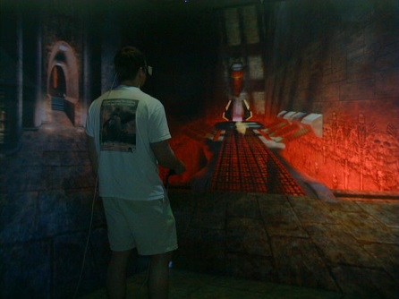
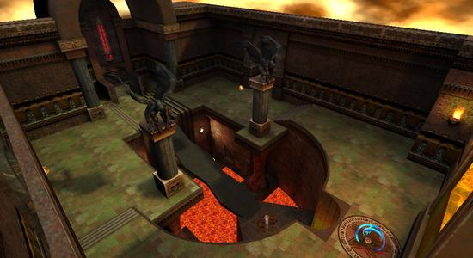
Background Work
Semi-structured interview with Phil Heslop
Senior Technician in charge of the VR suite
Current:
CaveQuake – Quake3 renderer for the CAVE
CAVELib – API responsible for displaying graphics
New:
Essentially re-writing CAVELib
Alternative tracking methods such as via Wiimote
Decoupling the system from the hardware
Notes:
In order to get a more concrete understanding of the features and requirements of the toolset that I will be creating, I first conducted a semi-structured interview with Phil Heslop to determine how the current process works and any improvements that could be made. Phil is the senior technician who runs the virtual reality suite and as such has a lot of experience with the technology, as well as a detailed knowledge of what the solution should comprise.
Currently the CAVE uses the CaveQuake engine, which is a Quake3 renderer developed specifically for the CAVE. Although this is sufficient for producing various 3D models, it is also commercial software that is now relatively dated and restricted.
In addition to this, the CAVELib API is used, which is proprietary software in control of making everything stereo and ensuring that the graphics are displayed correctly across the 3 screens. It is based on OpenGL commands, however it loses out to regular OpenGL applications because it doesn’t have knowledge of shaders. As a result it is graphically limited and no future CAVELib releases are expected, meaning it is unlikely that this feature will ever be added to the API.
Consequently the option of a more current and open platform is quite important and in order to achieve this I will essentially be re-writing CAVELib for a modern system. By doing so I will be removing these dependencies as well the need for a commercial licence.
Phil also expressed a desire for the system to be capable of using alternative methods of tracking to infrared. This is because modern hardware such as the Wiimote is now readily accessible and provides newer and more advanced methods of tracking with relative ease.
In general from my talk with Phil I understood that there was a strong emphasis on decoupling the system from the hardware so that if required they can be developed and used more independently of each other.

Slide 5
Key Technologies
Three possible directions:
Pure C/C++ engine
Pure three.js/WebGL implementation
Stereo might not be possible
‘Hybrid’ three.js/WebGL with a C/C++ program to piece back together for stereo
Still under investigation
Too early to begin development; still learning graphics and C++
Sensible to make right choice and ensure high quality end result
Notes:
In order to implement this toolset there are three possible directions that I could take.
The first would be to implement a pure C or C++ engine, capable of understanding and delivering 3D images to the user. By using these technologies I will have access to all of the functionality required, however it may be overly-complicated in terms of achieving the desired result.
The second option is to develop the solution using the three.js JavaScript library in conjunction with the WebGL JavaScript API. This choice has the benefit that three.js is both lightweight and extensively documented and supported. These are both crucial characteristics in providing a solution that is future-proof and that can be understood by those without advanced programming or graphical knowledge.
However, with these technologies it might not currently be possible to provide stereo images. Given the intended use of the toolset, stereoscopy is a relatively crucial feature and the lack of it could be too much of a drawback in making these technologies a viable choice.
This brings me to the third possible direction, a ‘hybrid’ application that would consist of a three.js and WebGL implementation capable of creating and rendering the graphical models, running in conjunction with a C or C++ program that would take the images being output from three.js and then essentially ‘piece’ them back together in order to achieve a stereo image.
Given that there are several possible technologies that could be utilised for my project, it is still under investigation by myself, my supervisor and Phil regarding which of these will be the most appropriate in terms of getting the desired results in a realistic and achievable timeframe.
However this is not a issue because, given that I am still studying both graphics and C++ in my modules, it is too early to ‘jump in’ and begin developing at the moment anyway. Therefore I have the opportunity to be sensible and continue this investigation so that I can know I am making the right choice to help ensure a working and high quality end result.
With regards to security implications, I will consider these as I develop, however the focus of this project is not on security so there won’t be a substantial amount of time designated to this.

Slide 6
Remaining Work
Notes:
As stated previously it is still not yet fully decided which technologies I will be using in order to implement this toolset. As a result, making that decision is one of the first tasks that I must complete before beginning development work. However I can still define some of the individual tasks that will be involved in developing a successful result.
This Gantt chart shows the main deliverables of my project, including the various submissions that must be made to NESS throughout the year. The first task that I aim to complete is the planning and estimation of my project. Once the technologies are decided and I have a more accurate idea of how long to allow for various aspects of the toolset, I can confidently begin development work.
Alongside this planning, I also intend to be continually writing and adding to my project proposal, as more details are established and I gain a more solid understanding of them.
The chart shows that the majority of the work involved in my project will be centred around development, as it is important that my end solution comprises certain features. Breaking this down into further sub-tasks allows me to identify a number of preliminary development jobs that I will undertake.
Initially I will complete profiling with three.js, so that I can gather data relating to the performance of this JavaScript library. It’s important that my toolset can provide an output of 100+ frames-per-second and as such, a base performance value will be useful in evaluating the performance of my own system.
Following this I can perform similar profiling on a relatively simple stereo C++ version. I can then compare and evaluate the performance of the two, potentially giving me information needed in order to decide which is the most appropriate technology to use in my particular case.
Once development work is fully underway, I envisage to begin testing alongside this, so that I can identify and fix any potential bugs early on in the development stage. This should help to mitigate any risks and also increase the quality of my end program.

Slide 7
Project Organisation
I intend to use an agile software process model
Implementing independent features
Estimated work for each task has potential to change during work
Allows working prototype to be demonstrated
SCRUM
Short iterations to implement one or a number of backlog items/features, depending on their estimated difficulty and duration
Demonstrate iteration work completed to Phil
Get feedback
Discuss any impediments
Notes:
Throughout my project I intend on using an agile software process model. This is because I will be implementing various features into the toolset one at a time and certain tasks have the potential to take less or more time than initially planned, due to any issues that I may run into during development. A process model such as SCRUM allows change with ease and will ensure that my project can be organised and sufficiently planned.
Another benefit of using an iteration and sprint focussed cycle is that I can constantly have a working prototype available and frequently demonstrate this to Phil in order to receive feedback, like a sprint review meeting. In that sense, I am seeing Phil as the product owner with this toolset. We will also be able to discuss any impediments that may have arisen during the iterations work.

Slide 8
Evaluation
Most objectives are features that the toolset should include
Does the functionality exist?
Does the feature work as expected?
Measuring share-ability
Relatively subjective
Phil’s opinion based on his experience using the current system
Is the new solution less, equally or more shareable?
Measuring usability
Again based on Phil’s familiarity with the current system and how my toolset compares
Notes:
Due to the nature of my project, many of my objectives are features that my toolset will or won’t include. Therefore they will simply be evaluated on this basis and if the feature hasn’t been implemented or if it doesn’t function as expected, I can say that the objective has not been met. Otherwise, if the feature exists and functions correctly, the objective has successfully been met.
With regards to evaluating the share-ability of the toolset, this is a relatively subjective characteristic and as such its success will be rated primarily on Phil’s opinion, related to his experience with the current system. However one possible test that I could undertake in order to measure the share-ability of the toolset would be to determine how many devices can display the images being output. For example, an onsite system, an offsite laptop, a tablet, a mobile phone etc. In general, I could assume that a more shareable system will be accessible on a greater number of devices.
Measuring the usability of the toolset will again predominantly be evaluated based on Phil’s comparison between the current system and my toolset.
Upon completion of the project I will also be able to evaluate a number of other aspects of the toolset, namely whether it has met certain performance requirements. Here I intend to profile my toolset and measure the average FPS; I aim for the system to be capable of 100+ FPS.

Slide 9
Summary
Developing a backend toolset for the university’s CAVE
To be used for admissions day demos
Running psych studies
Deploying architectural visualisations
Models can be viewed and explored using the technology provided by the CAVE
3D models
Motion-tracking
Shareable
Useable outside the CAVE
Likely to be web-based
Notes:
In summary, my project entails me investigating, designing and developing a bespoke toolset that can be used to control the university’s CAVE. The toolset will be capable of understanding and displaying 3D models.
It is intended that this will be beneficial in the use cases of admissions open days, the running of psych studies and also for deploying architectural visualisations. I mention these particular use cases as they will benefit directly from use of the CAVE’s technology; motion-tracking will provide users with the ability to walk around and explore the models being displayed. Also, their reactions and data can be analysed in order to perform psych studies and experiments with the new system.
Finally, it is also expected that the toolset will be useable outside the CAVE, that is it can be deployed via the web, potentially allowing it to be viewed on any compatible device with a web browser, thus massively increasing the number of potential users of the system.

Slide 10
References
http://www.iri-vr.ncl.ac.uk/ - Newcastle University VR suite
http://www.mechdyne.com/cave2.aspx - CAVE2
http://www.visbox.com/cq3a/ - CaveQuake III
http://www.mechdyne.com/cavelib.aspx - CAVELib

Slide 11
Questions?
Notes:
Thanks very much for listening. I would now like to welcome any questions that you may have.

